Slide 1

MEDIWISE - A Healthcare Chatbot using NLP
SRM INSTITUTE OF SCIENCE AND TECHNOLOGY
SCHOOL OF COMPUTING
DEPARTMENT OF COMPUTING TECHNOLOGIES
18CSP107L - MINOR PROJECT
Batch ID: B028
Student 1 Reg. No: RA2011003010098
Student 1 Name:Aniket Mishra
Student 2 Reg. No: RA2011003010124
Student 2 Name: Nandini Nigam
Guide name: Dr. T.K Sivakumar
Designation: Assistant Professor (Senior Grade) Department: CTECH

Slide 2
MEDIWISE
Abstract
This project aims to develop an innovative and intelligent conversational agent to enhance healthcare services and improve patient experiences.
It is designed to provide a wide range of healthcare-related
services like symptom assessment, health education, and general medical inquiries.
Through its intuitive interface and empathetic conversational style, the chatbot aims to bridge the gap between patients and healthcare providers, promoting efficient communication and reducing the burden on medical staff.
This project aims to provide a scalable, accessible, and user-friendly solution
that can be integrated into existing healthcare platforms contributing to the overall improvement of healthcare delivery and patient outcomes.

Slide 3
MEDIWISE
Introduction
In the rapidly evolving landscape of healthcare, technology has emerged as a transformative force, reshaping how medical services are delivered and experienced.
Mediwise aims to harness the power of cutting-edge artificial intelligence and natural language processing to revolutionize patient interactions
The development of an intelligent conversational agent holds immense potential
to bridge gaps, enhance patient engagement, and streamline medical processes.
By leveraging technology’s effectiveness, this endeavor aspires to cultivate a more patient- centric, efficient, and responsive healthcare ecosystem.

Slide 4
MEDIWISE
Existing System
Conversational Empathy
Comprehensive Healthcare Services
Diverse Data Integration
Use of efficient technology along with enhancements
User Centric Designs
Scalability
Flexible Design

Slide 5
MEDIWISE
Problem statement and Objectives
"Mediwise," connects patients and healthcare providers, aiding tasks like symptom assessment and medical queries.
The chatbot aims to empower patients, improve communication, and advance healthcare technology with NLP algorithms and data insights.
The goal is efficient, patient-centric care, revolutionizing healthcare delivery for improved outcomes and seamless tech integration.
This project aims to use AI and natural language processing to create a smart conversational agent that overcomes limitations in traditional patient-provider communication.
By offering personalized and immediate assistance, individuals can access medical information and understand health conditions.
Additionally, it lightens the load on medical staff, allowing for improved resource allocation and focused patient care.

Slide 6
MEDIWISE
Proposed System
This Project introduces a revolutionary conversational agent with innovations including:
1. Advanced NLU: Understands context for precise responses.
2. Emotionally Aware: Responds empathetically, adapting to users' emotions.
3. Dynamic Learning: Improves over time with continuous learning.
4. Comprehensive Services: Offers various healthcare services.
5. Integration: Seamlessly fits into existing healthcare platforms.
6. Real-time Analytics: Provides insights into patient needs and trends.

Slide 7
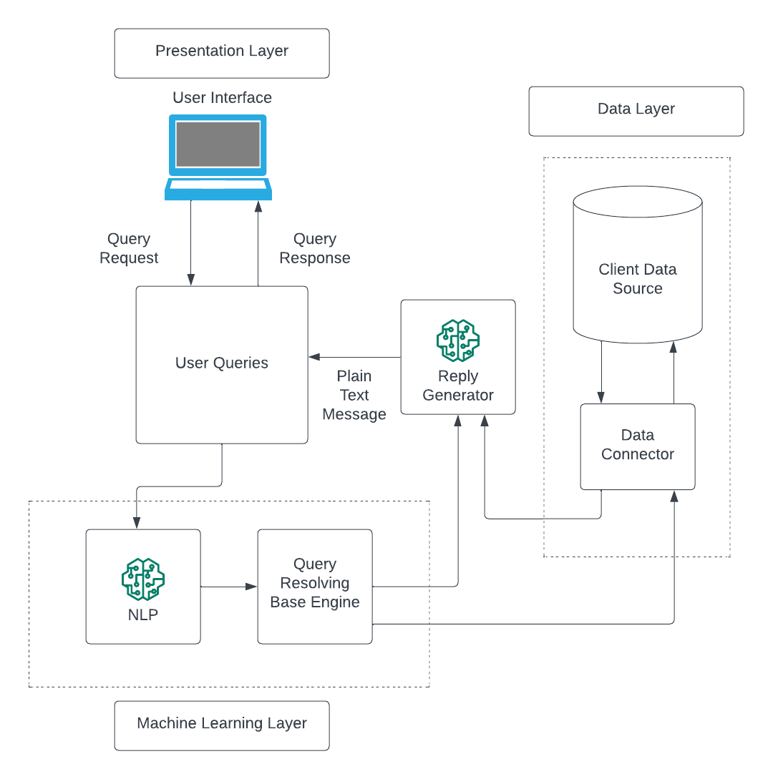
MEDIWISE
Architecture/Block Diagram of the proposed model

Slide 8
MEDIWISE
Modules Description
The Healthcare Chatbot project utilizes a combination of programming languages and libraries to achieve its goals:
Python is used as its primary language
Natural Language Processing (NLP) Libraries:
NLTK (Natural Language Toolkit): Used for various NLP tasks like tokenization, stemming, and sentiment analysis.
spaCy- Offers advanced NLP capabilities
Machine Learning and AI Libraries:
Scikit-learn: For data preprocessing.
TensorFlow or PyTorch: For developing and training

Slide 9
MEDIWISE
Modules Description
4. User Interface Libraries:
HTML, CSS, JavaScript: For building the user interface of the web application.
5. Data Analytics Libraries:
Pandas: For data manipulation and analysis.
NumPy: For numerical computations.
6. Web Frameworks:
Flask: For creating the web application interface and managing user interactions.
7. Cloud Services:
Amazon Web Services (AWS) or Microsoft Azure: For hosting and deploying the chatbot application.

Slide 10
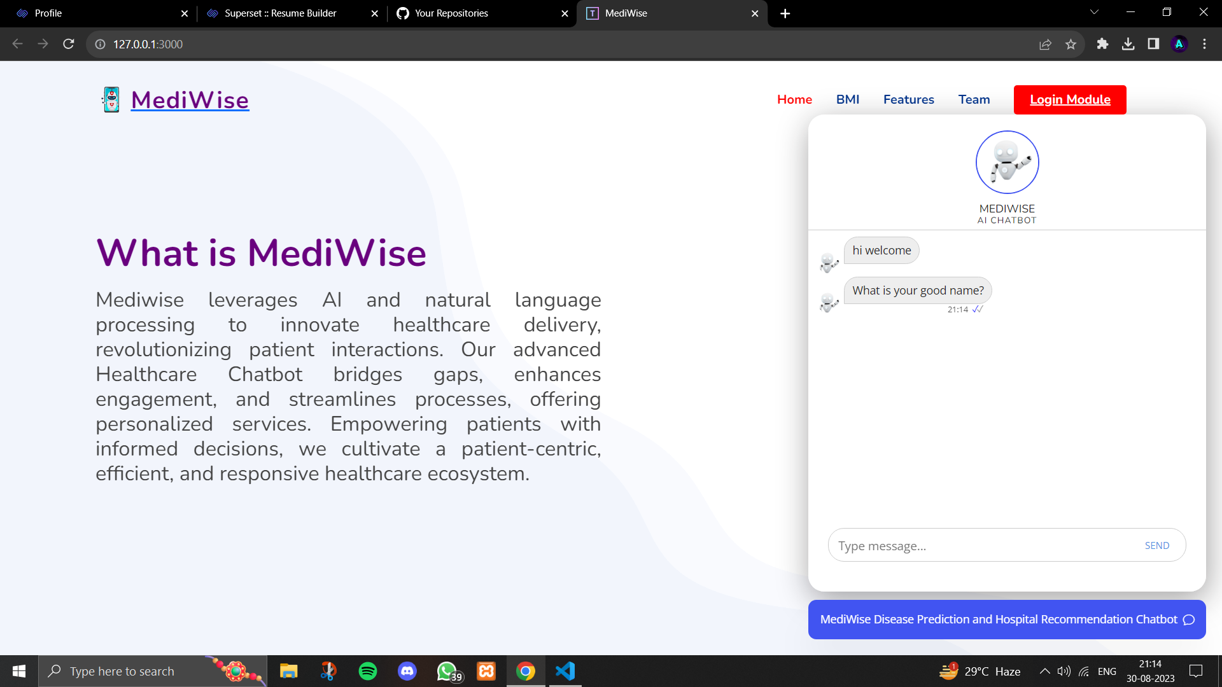
MEDIWISE
Intermediate Results and Discussion

Slide 11
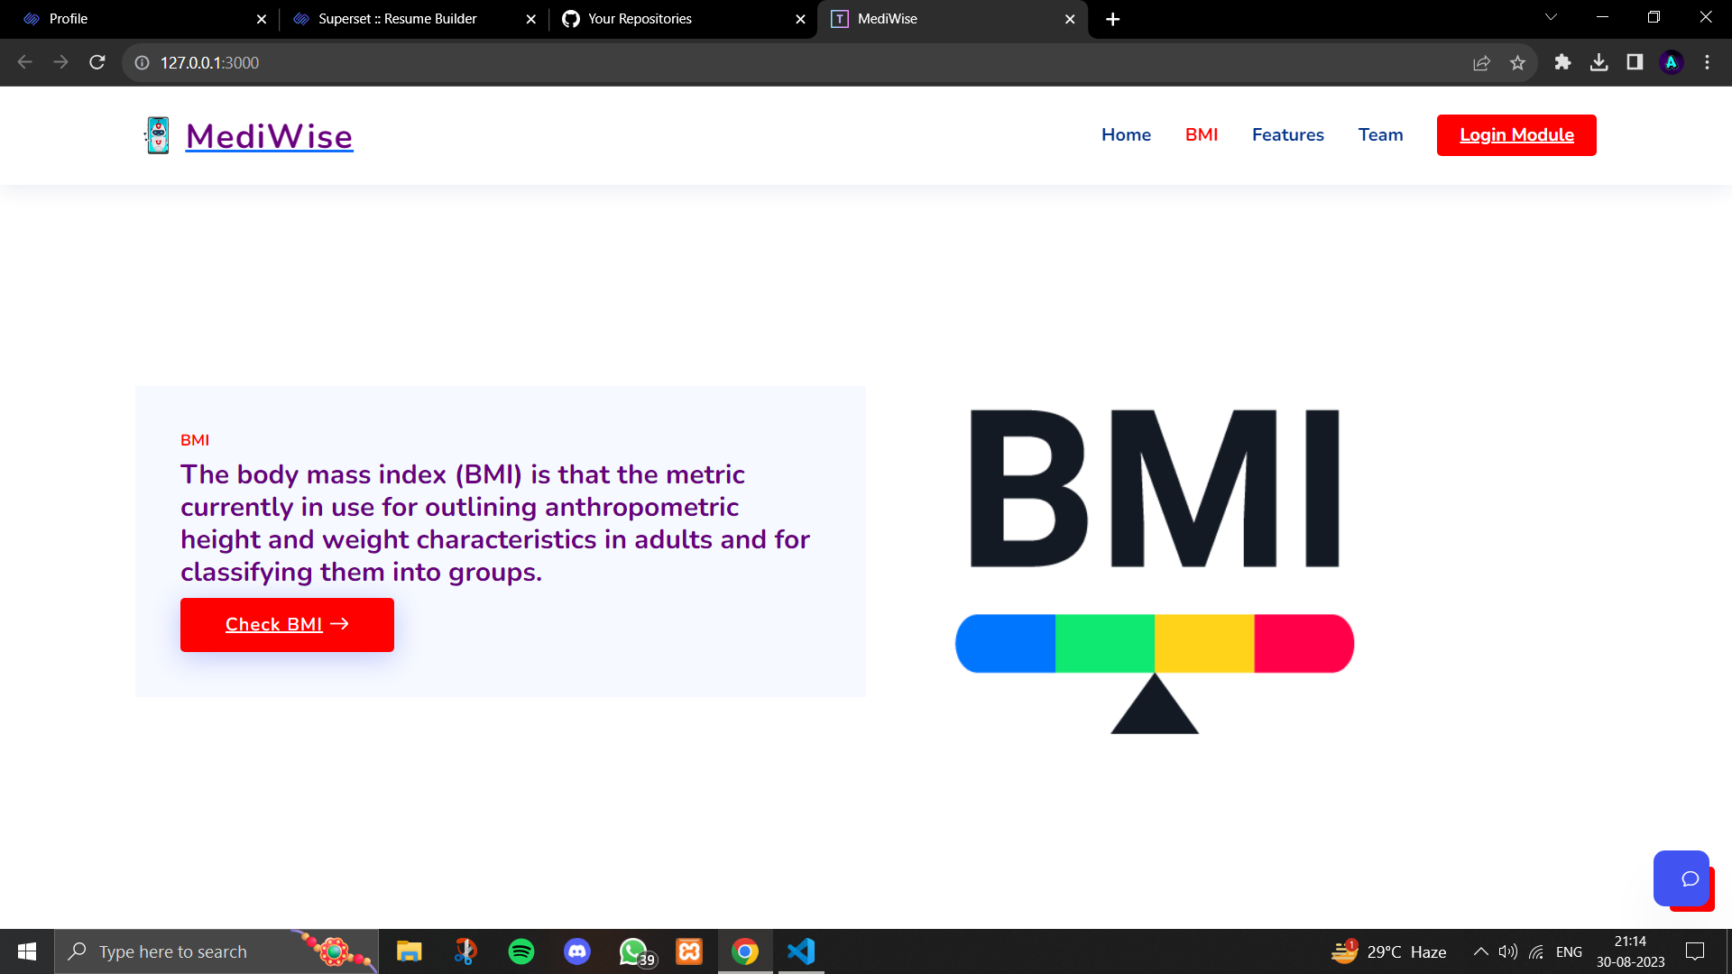
MEDIWISE
Intermediate Results and Discussion

Slide 12
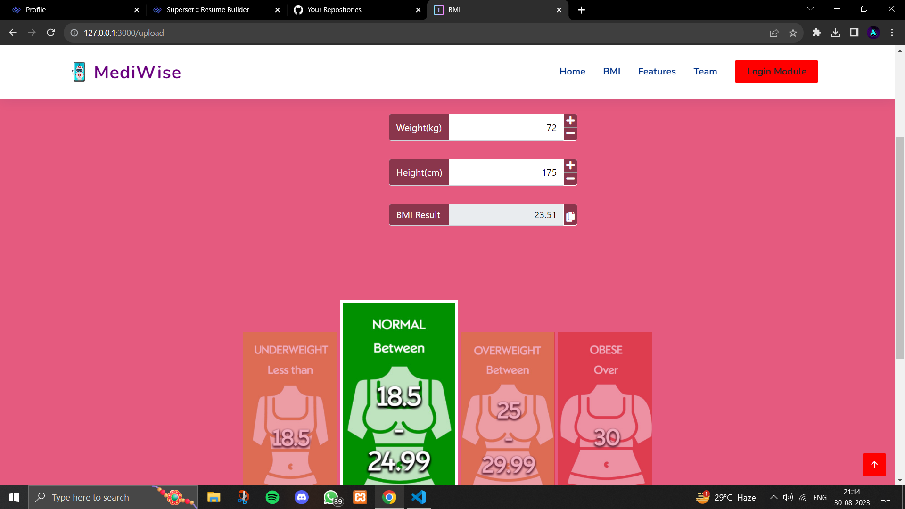
MEDIWISE
Intermediate Results and Discussion

Slide 13
References

Slide 14
Questions?

